Slide 1
Monitoring invertebrates for crop production
Tom Pope tpope@harper-adams.ac.uk

Slide 2
What is an insect pest? (Pt1)
A pest is something that:
Reduces the yield of a crop
Reduces the quality of a crop
Appearance, taste etc
Affects the health of humans and livestock
Ultimately
A pest is any species that we, as humans, consider to be undesirable

Slide 3

What is an insect pest? (Pt2)
The Food and Agriculture Organisation (FAO) of the United Nations defines a pest as:
‘Any species, strain or biotype of plant, animal or pathogenic agent injurious to plants or plant products’

Slide 4
A working definition of IPM
Kogan (1998) Annnual Review of Entomology. 43: 243-270
“IPM is a decision support system for the selection and use of pest control tactics, singly or harmoniously coordinated into a management strategy, based on cost/benefit analyses that take into account the interests of and impacts on producers, society, and the environment”

Slide 5
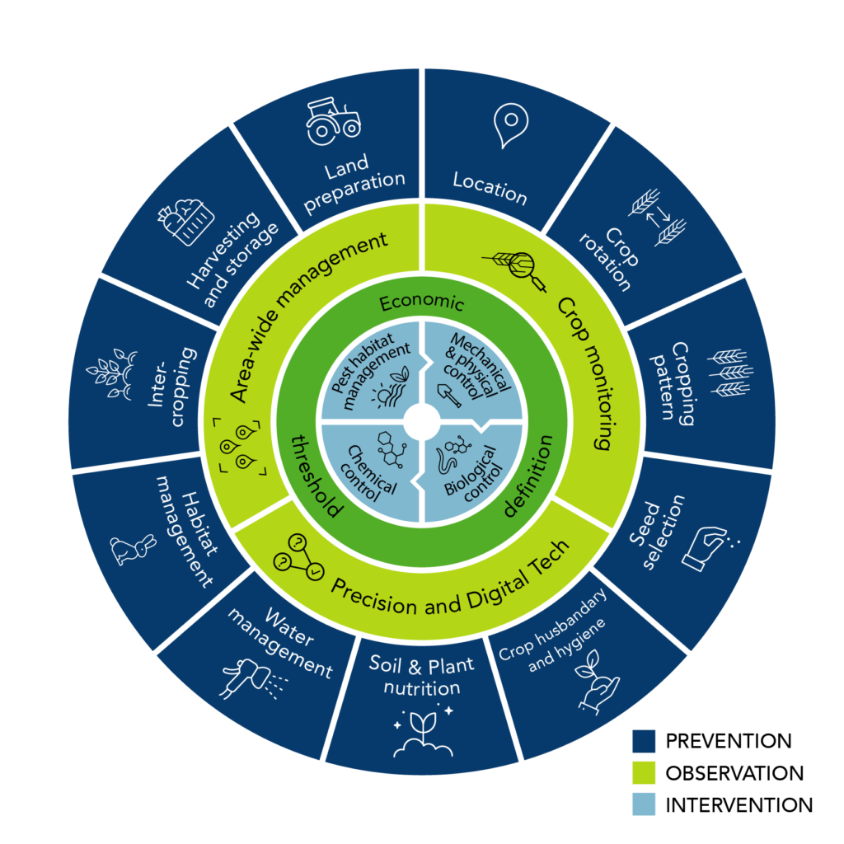

What is an IPM programme?

Slide 6
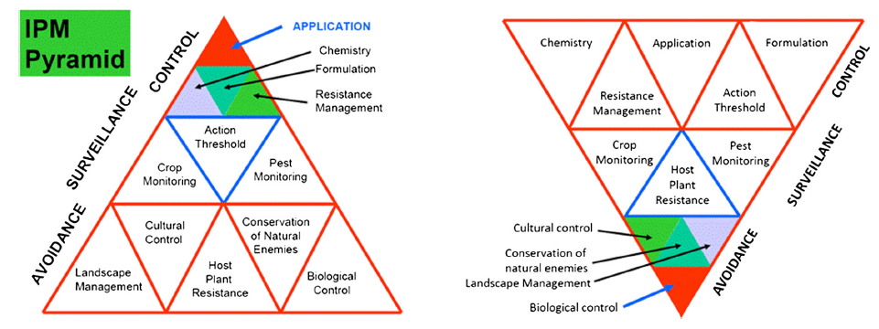
Reality gap in IPM?
Hokkanen (2015) Arthropod-Plant Interactions. 9:543–545

Slide 7
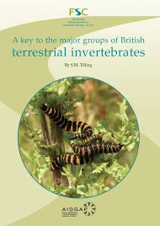
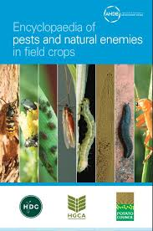
Before we can monitor a pest population
Requires understanding of:
Identification – not all insects are pests
Life cycle – long or short-lived, when are they active, when do they reproduce etc.
Feeding – generalist or specialist
Distribution – even or patchy
Where – are the pests in the soil, leaves, flowers etc.

Slide 8
How do we monitor pests? (Pt1)
Count pests on the plant:
Simple, requires no equipment
Can give a rapid answer (depends on pest)
But
May be time consuming (again depends on pest)
May require detailed knowledge of the pest
Only a small area of the crop sampled
May need to be repeated
Pollen beetle

Slide 9
How do we monitor pests? (Pt2)
Count pests in soil samples:
May provide advanced warning
May complement other monitoring techniques
But
Soil samples often need to be processed in a laboratory
Time consuming and expensive
Not always reliable
Only appropriate for pests which complete at least part of their lifecycle in the soil
Soil sampling

Slide 10
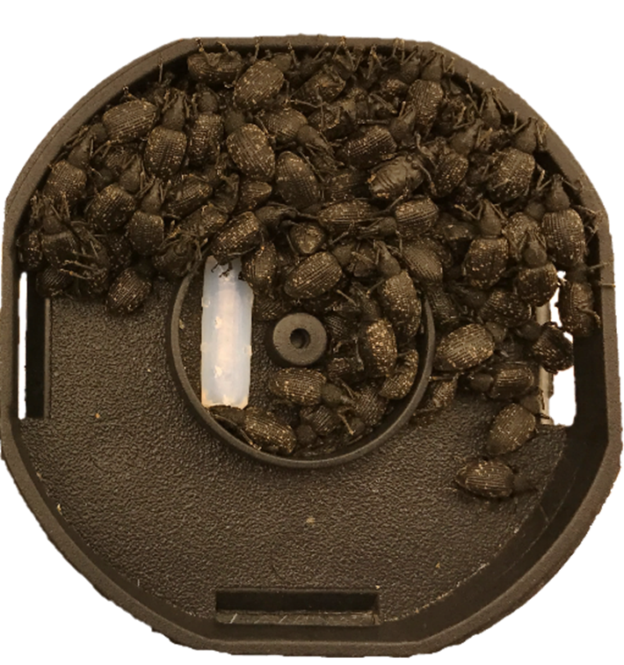
How do we monitor pests? (Pt3)
Trap pests using artificial refuges:

Slide 11
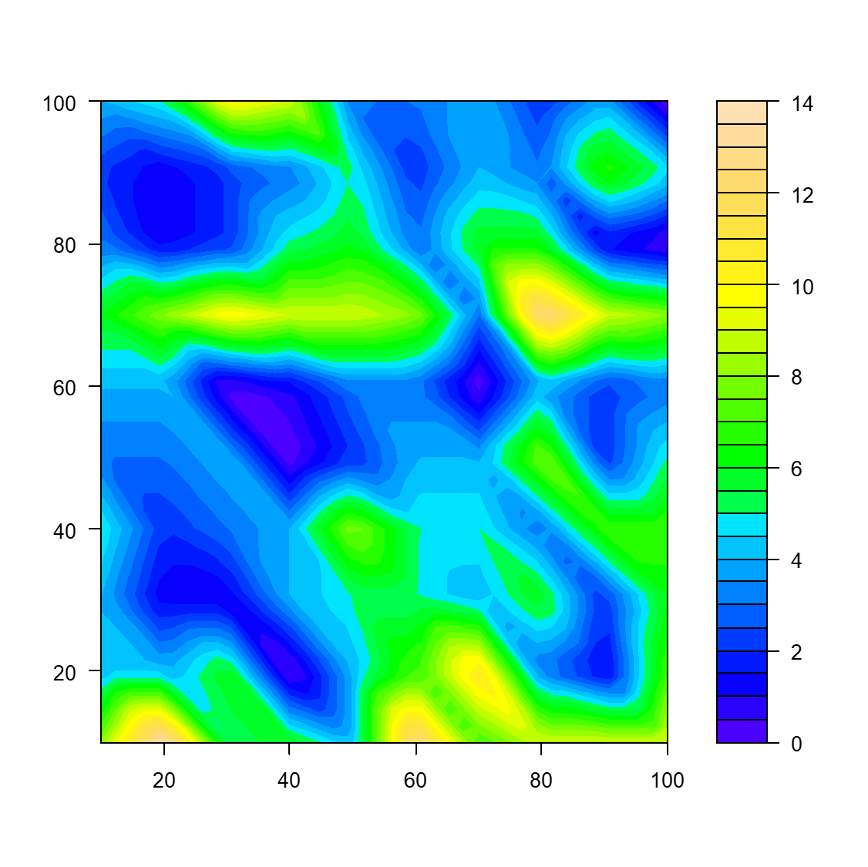
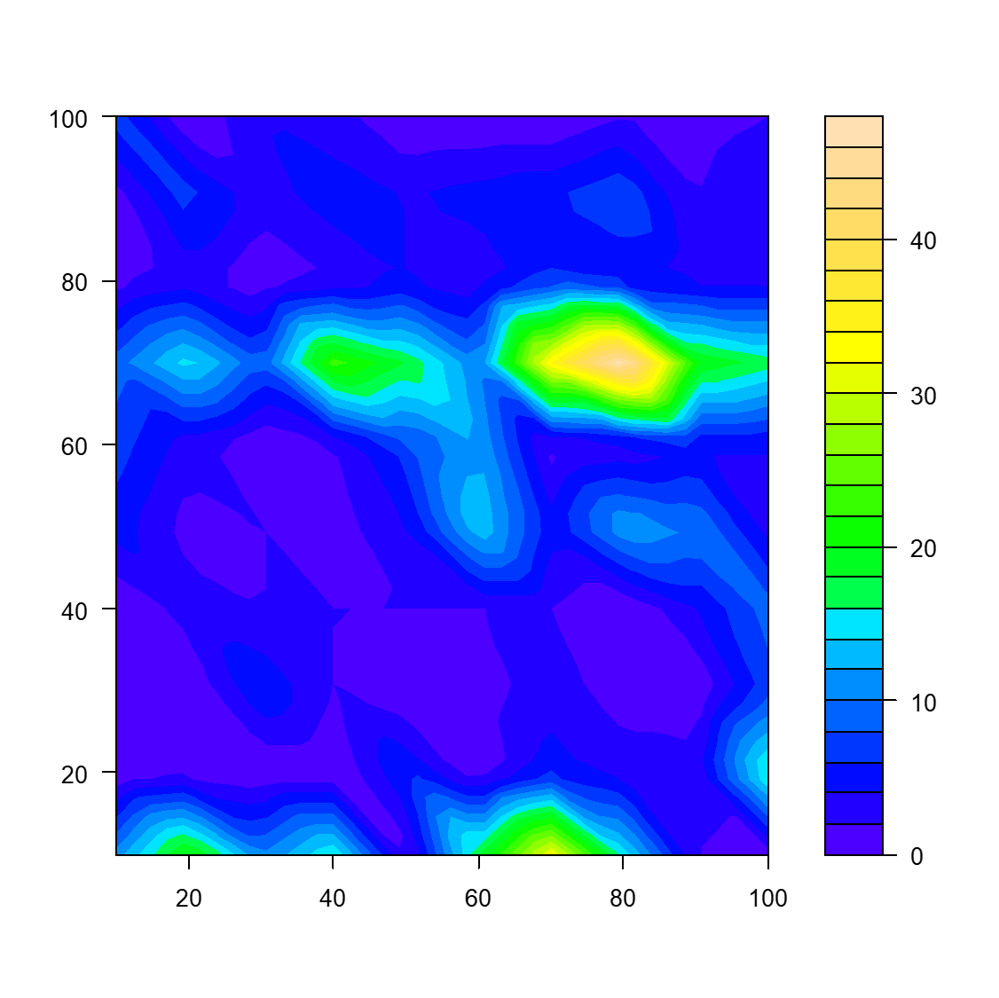
How do we monitor pests? (Pt4)
Count pests within refuge:
May provide advanced warning
Useful for nocturnal pests or pests that may spend time in the soil
But
Refuges may need to be checked regularly
Catches may be determined by other factors e.g. natural refuges, food sources and environmental conditions
Samples a small area of the field

Slide 12
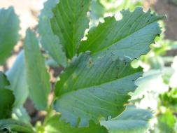
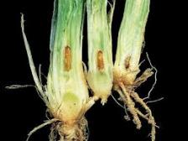
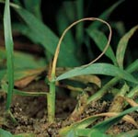
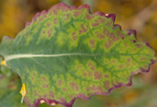
How do we monitor pests? (Pt5)
Record pest damage:

Slide 13
How do we monitor pests? (Pt6)
Record pest damage:
Avoids the need to find the pest itself
Damage is often more obvious and can be quickly recorded
But
Recording pest damage may not always be pest specific
It can be difficult to quantify pest damage i.e. often presence/absence
Too late to prevent damage, this may not be acceptable in certain crops

Slide 14
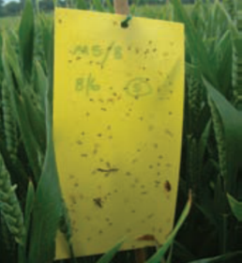
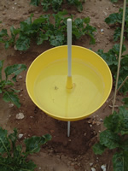
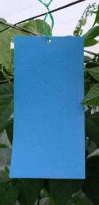
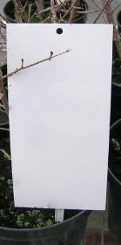
How do we monitor pests? (Pt7)
Trap pests using colour:
Yellow sticky trap
Yellow water trap
Other colours of sticky trap

Slide 15
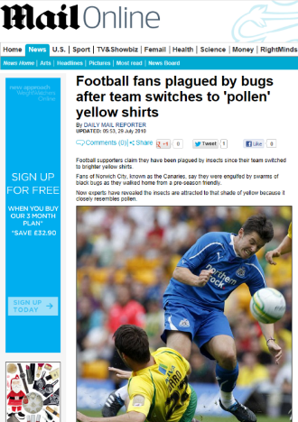
How do we monitor pests? (Pt8)
Trap pests using colour:
Quick and easy to use
Usually effective
But
Not species specific, may require specialist knowledge
Traps need to be checked regularly

Slide 16
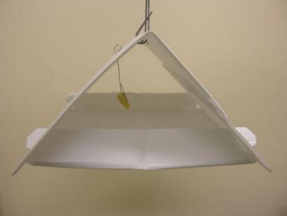
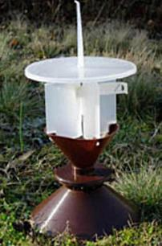
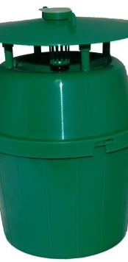
How do we monitor pests? (Pt9)
Trap pest using odour (e.g. pheromone):
Typical pheromone trap (Delta trap)
Other pheromone trap designs e.g. cross vein and funnel

Slide 17
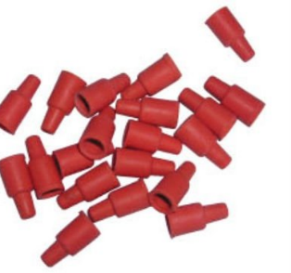
How do we monitor pests? (Pt10)
Trap pests using odour (e.g. pheromones):
Very effective, traps pest even at low densities
Species specific
But
Usually only traps males
Traps need to be checked regularly
Traps need to be calibrated
May be expensive
Rubber septum impregnated with pheromone

Slide 18
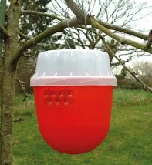
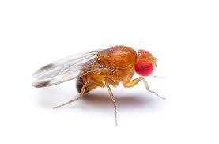
How do we monitor pests? (Pt11)
Trapping pests using odour is not just about pheromones
Allelochemicals may also be used, however:
Typically, not species specific
May lack sensitivity compared with pheromones
But
Often traps females
Traps need to be checked regularly
Traps need to be calibrated
May be expensive
Spotted wing drosophila trap

Slide 19
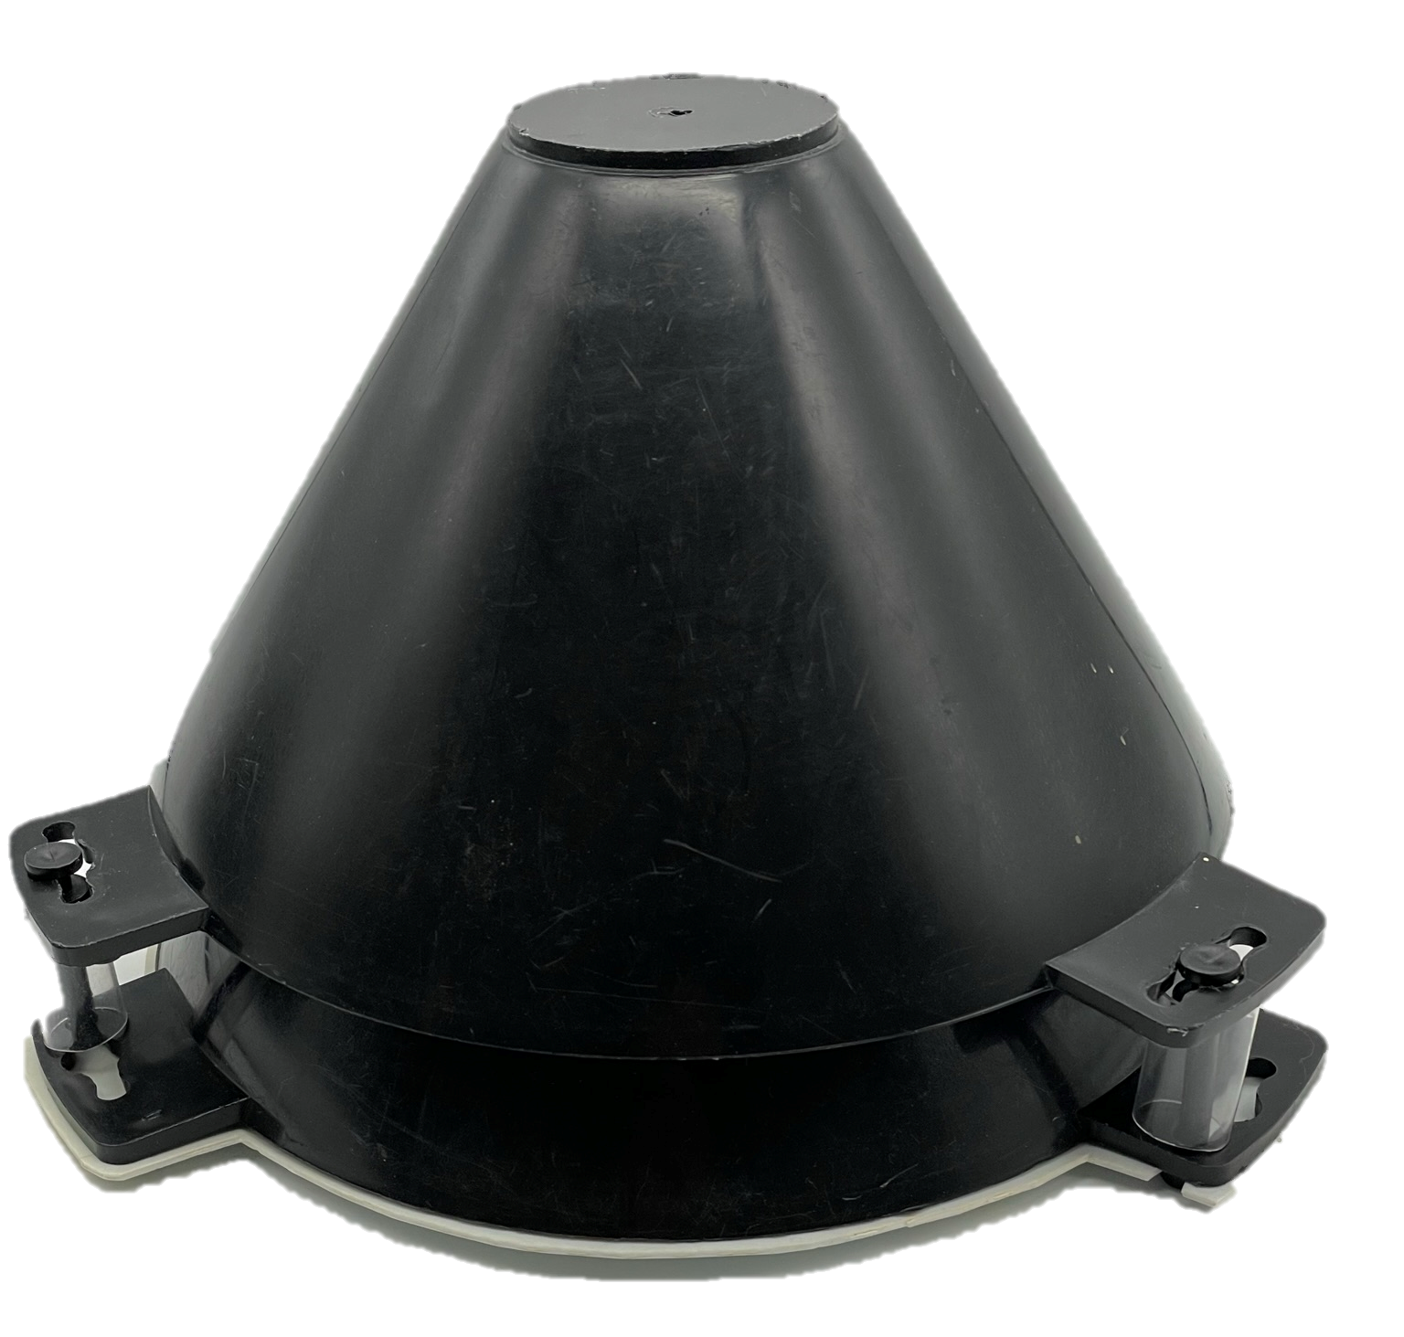
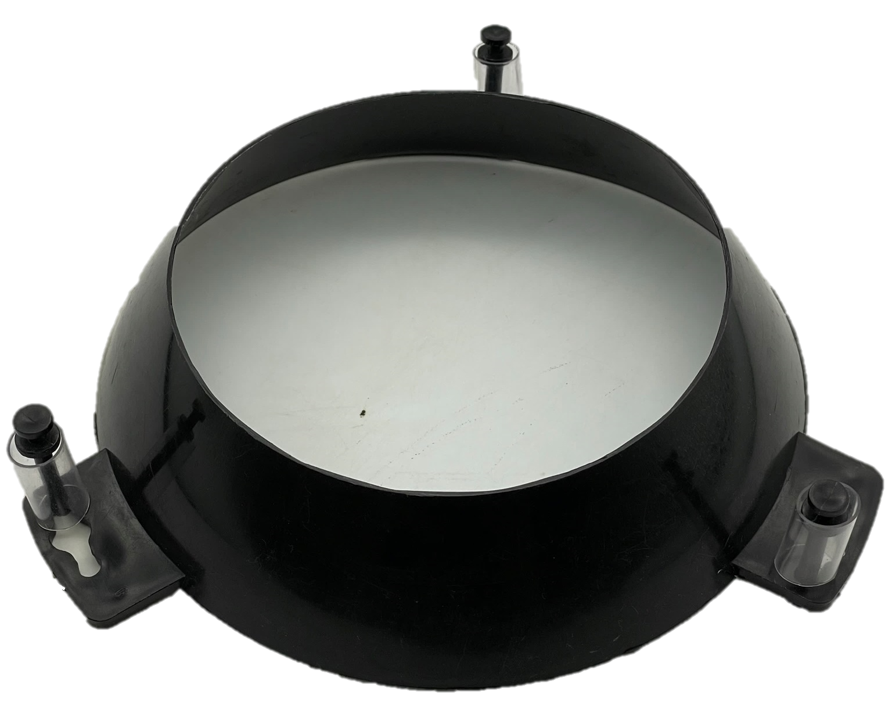
The future of monitoring is ‘smart’
Colour
Profile
Entrance location
19
19

Slide 20
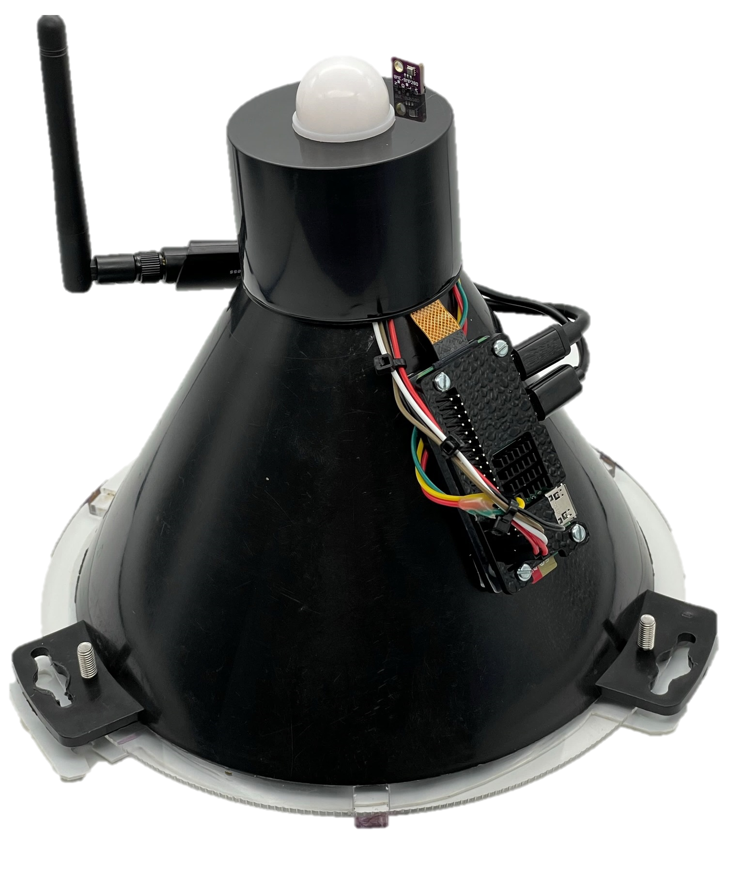
Monitoring tool evolution
20

Slide 21
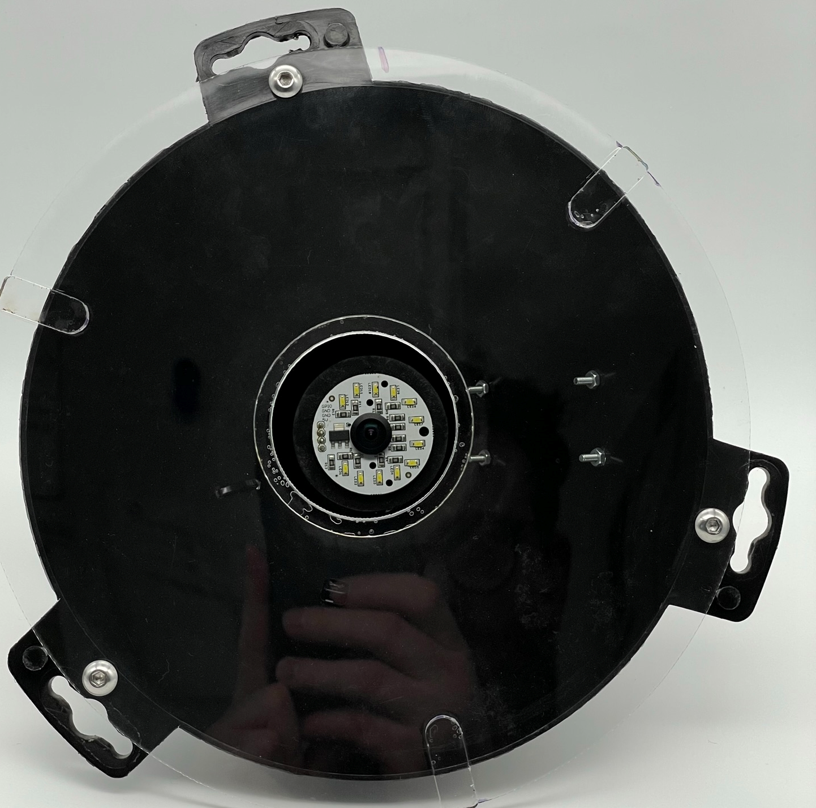
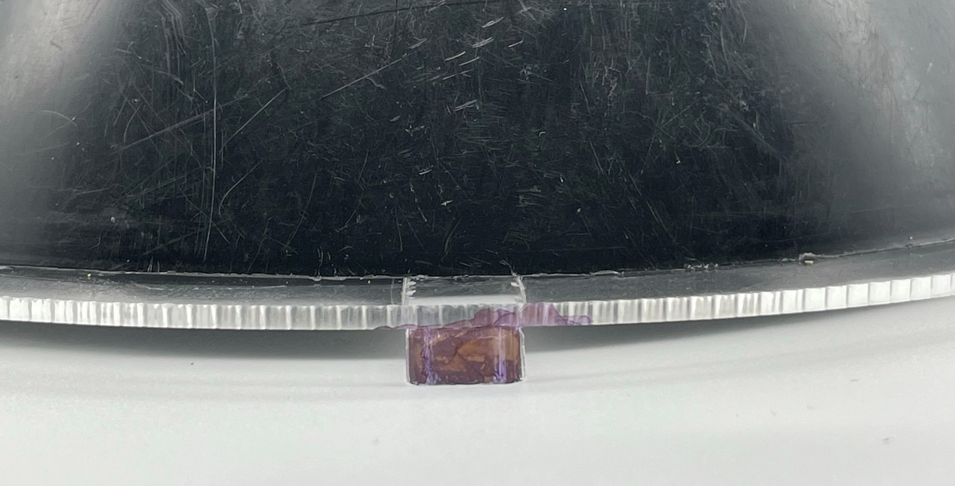
Environmental sensors
WiFi antenna
Raspberry Pi Zero 2W
Camera / LED light
Acrylic disc
21

Slide 22
Making a smart monitoring tool
Images were collected every 10 minutes to create a training repository
Differences between images identified regions of interest and singled out individual vine weevils using ‘white space’ filtering
Over 1300 images were captured with 5977 regions of interest
TensorFlow Lite model trained to classify organisms

Slide 23
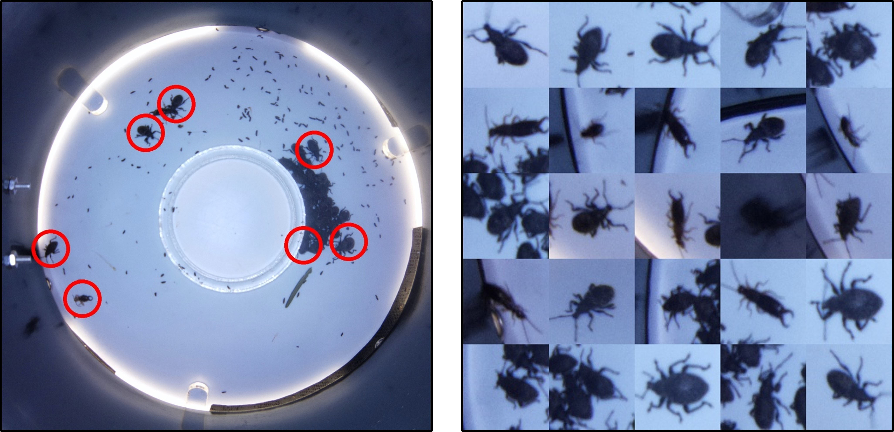
23

Slide 24
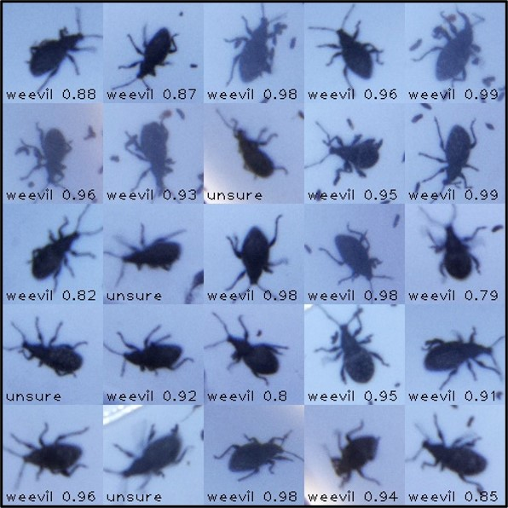
How smart?
85 ± 10 % model confidence
16 ± 2 % of images unclassified
No incorrect identifications

Slide 25
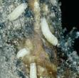
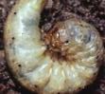
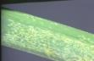
How do we monitor pests? (Pt12)
National monitoring schemes:
AHDB Pest Bulletin: AHDB Pest Bulletin
Brassica pests e.g. cabbage root fly, aphids, pollen beetle
Carrot & parsnip pests e.g. carrot fly, aphids, cutworm
Leaf & onion e.g. thrips, bean seed fly, cutworm
Cabbage root fly
Cutworm
Thrips damage

Slide 26
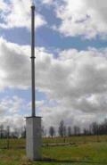
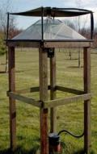
How do we monitor pests? (Pt13)
National monitoring schemes:
Rothamsted Insect Survey: Rothamsted Insect Survey
Aphid suction trap network
Light trap network
Rothamsted suction trap
Rothamsted light trap

Slide 27
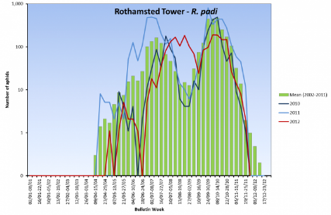
Can we forecast pests? (Pt1)
Pest forecasts require an understanding of the pests biology
Often forecasts are
Based on historical records
Based on meteorological data
Long-term trends in numbers of migrating bird cherry-oat aphids

Slide 28
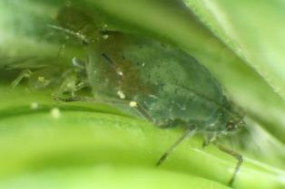
Can we forecast pests? (Pt2)
Aphid forecasts
Based on average temperatures in January and February
Colder temperatures in January and February = fewer aphids in the spring and aphids fly to cereal crops later
Bird cherry-oat aphid

Slide 29
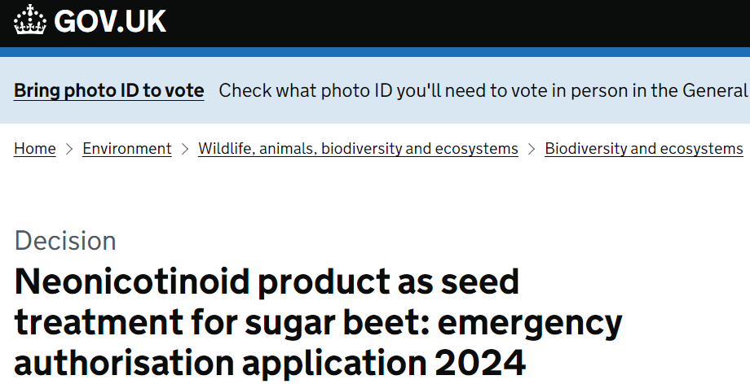
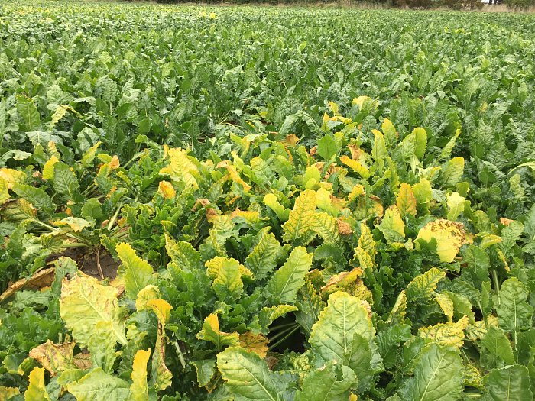

Can we forecast pests? (Pt3)

Slide 30
Summary
Correct species identification is an essential first step to any IPM programme
Once a pest has been correctly identified more information about that pest becomes available
This information informs monitoring approaches, thresholds and controls that may be used

